Slide 1

Downtown Troy
Ridhee Shinde, Yash Choksey, Eric Carson, Shirley Tom
Notes:
ridhee

Slide 2


Hello! We’re…
RTAN which stands for Rensselaer Team of Awesome Networkers
Notes:
ridhee

Slide 3
Overview
Introduction to our Project
Intended Users
Summary of the Technologies Implemented
Site Features
Demo of Website
Notes:
ridhee

Slide 4
So what is the Downtown Troy Website?
01
Our website includes many restaurants downtown and upcoming events catered to the Troy community and RPI students!
Notes:
ridhee

Slide 5
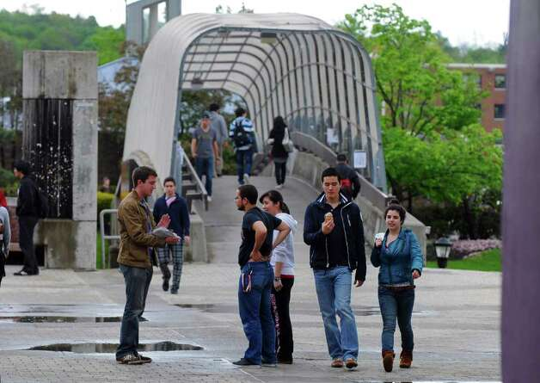
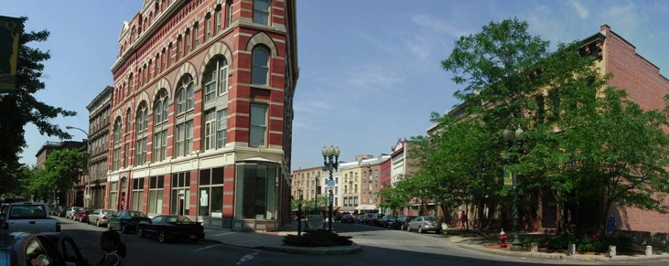
Intended Users
Troy Community
RPI Students
Notes:
Go into Stakeholder here - shirley
Troy community
residents
business owners
rpi students

Slide 6
Summary of Technologies
HTML + CSS + Bootstrap
Nav bar
Table formatting
Javascript + JSON
Form validation
Google Maps API
PHP + PDO
Login/Signup page with dedicated roles (business/normal user)
Sessions determine viewing/editing privileges
Manage database of users, restaurants, and events

Slide 7
Site Features
Role Change
Restaurants/Reviews
Events/Poll
- Standard login system includes all Troy residents
- Business and general role options
-Pull data from SQL database
- Reviews limited to one per user, can be edited at any time
- Business accounts can add events through About Us page
- Poll verifies prospective businesses
Notes:
We wanted to speak about major changes and why we made them

Slide 8
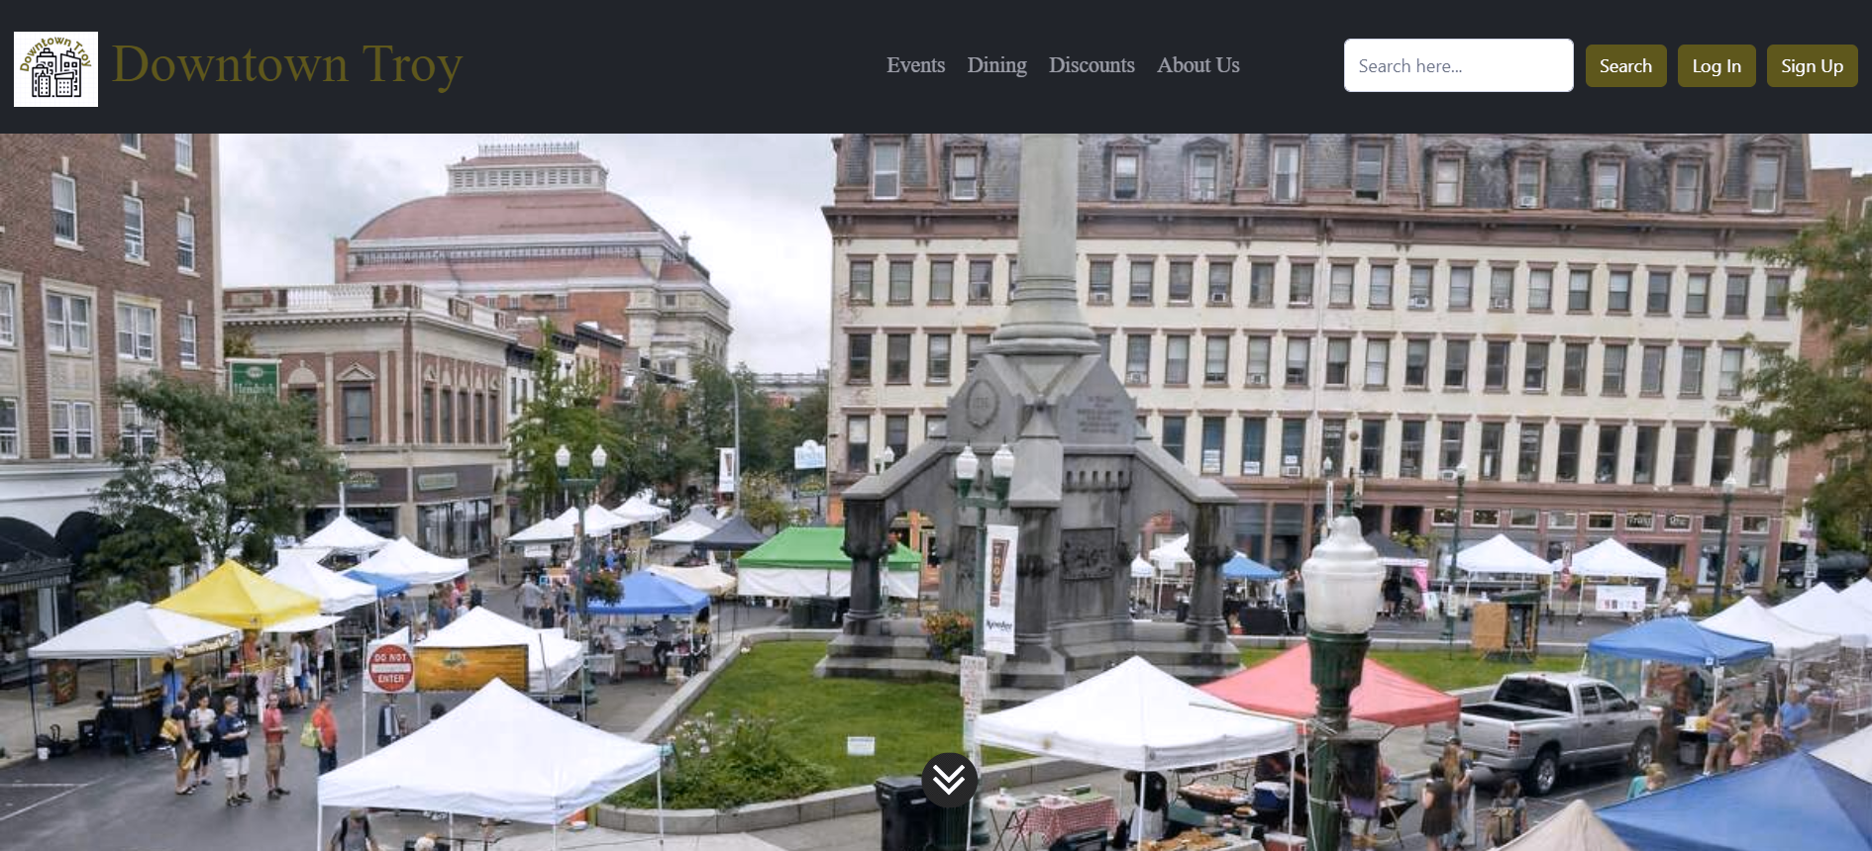

Now onto our demo of Downtown Troy
Notes:
Roadmap for demo:
Presents home page (nav bar, see more links) - ridhee
New user - eric
Sign up
Talk about direct.php, mention UI
Dining
Try to write a review (should fail)
Log out
Normal user - yash
Edit a review and show updated (shows can only write one review)
Dining page Google map API
Discounts
—-----------
Events - shirley
Transition to creating a business account - ridhee
logout
Log into business account
Events again (create an event)
Logout
- Search bar
Create business account
Show successfully sent email

Slide 9
Thank you!
Any Questions?

